Slide 1

AI-Powered RSS Feed Summarizer
End-to-End Automation Workflow
Project: 23071A05T9 — Sai Sanjeeth Ravva

Slide 2

OVERVIEW
Intelligent Information Streamlining
This project demonstrates an AI-driven automation workflow designed to streamline the collection, analysis, and summarization of information from multiple RSS feeds, providing daily, digestible insights.
Integrated Automation
Intelligent Summarization
Utilizes n8n, an open-source platform, integrated with Google Gemini for intelligent content processing without manual intervention.
The workflow automatically fetches the latest updates, processes them using natural language understanding, and generates concise, high-quality summaries.
Real-time Delivery
Enhanced Productivity
Summaries are formatted into a clean HTML report and delivered directly to the user's preferred channels, such as Telegram or Gmail.
This agentic AI system combines automation, reasoning, and communication to significantly reduce human effort in information management.

Slide 3
CHAPTER 1: GOALS & TOOLS
Workflow Objectives and Core Technology Stack
The primary goal is to transform passive consumption of RSS feeds into proactive, automated insight generation. This system handles the entire lifecycle, from fetching raw data to delivering refined summaries.
Key Tools Utilized
n8n
Open-source automation framework orchestrating the flow.
Reads Feed URLs
1
Google Gemini
Takes input from a structured CSV file.
Powerful AI agent for sophisticated summarization tasks.
Fetches Posts
2
Delivery Channels
Collects recent articles from each source.
Used for secure and timely notification (Telegram & Gmail).
Gemini Summarization
3
Formatting Nodes
Applies advanced AI to condense content.
Markdown and HTML nodes ensure clean, professional output styling.
Sends Formatted Output
4
Delivers via secure communication channels.

Slide 4
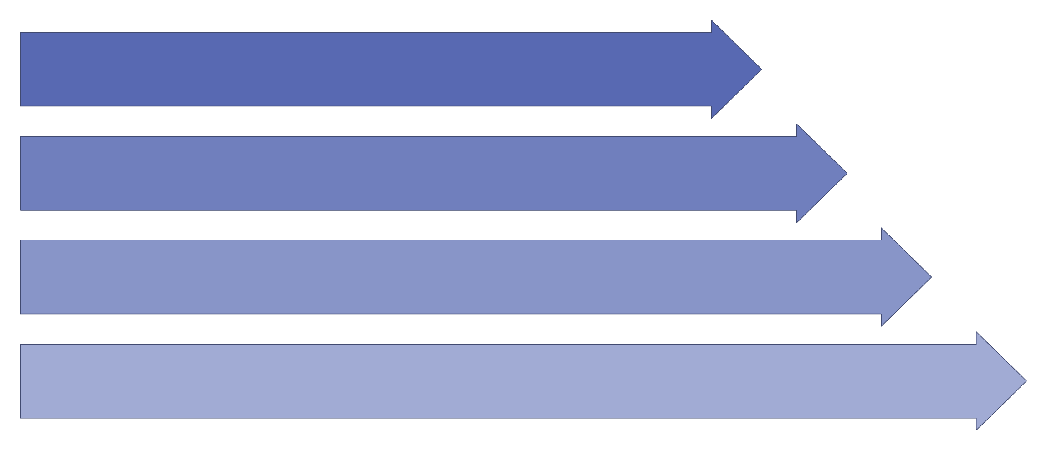
CHAPTER 2: WORKFLOW
System Architecture: From Trigger to Delivery
The workflow executes a series of logical steps, ensuring robust and consistent automated reporting on critical information streams.
Schedule Trigger
CSV Read
RSS Reader
Gemini Chat
1. Schedule Trigger: Initiates the entire workflow at predefined intervals (e.g., daily at 8 AM).
2. CSV Input: A secure file is read to fetch the latest list of RSS feed URLs to monitor.
3. RSS Collection: Specialized reader nodes fetch and structure new articles, titles, and descriptions.
4. AI Processing: The Gemini Chat Model ingests content and generates concise, actionable summaries.
5. Output Structuring: Markdown and HTML nodes refine the output for optimal readability on all devices.
6. Automated Delivery: The final report is automatically sent to the configured user communication endpoints.

Slide 5
Deep Dive into Critical Component Functions
Schedule Trigger
File Read & Extract
RSS Feed Reader
Ensures reliable, periodic execution, transforming the process from reactive to proactive monitoring.
Securely loads dynamic configurations, allowing easy updates to the monitored RSS feed list.
Handles the complex task of pulling and sanitizing data from various web sources.
Gemini AI Agent
Delivery Modules
The core intelligence layer responsible for generating high-quality, nuanced summaries.
Manages secure integration with Telegram and Gmail APIs for seamless notification.

Slide 6

Refined Output and Notification Formats
The final summaries are packaged for optimal consumption, whether on a mobile chat client or a desktop email interface, emphasizing readability and professional styling.
Telegram Integration: Summaries are delivered as concise, formatted messages, ideal for instant reading and mobile consumption.
Gmail Option: Summaries are delivered in rich, responsive HTML email format, allowing for detailed, aesthetically pleasing reports.
HTML Styling: Leveraging frameworks like Bootstrap and Markdown ensures a clean, professional, and consistent layout across all output channels.
Full Automation: The entire process is hands-off, executing reliably without requiring any manual interaction post-setup.

Slide 7


Conclusion and Roadmap for Future Scope
Impact & Value
This system dramatically saves time by automating the tedious process of reading and summarizing diverse RSS feeds. It provides significant business value by combining the reasoning capabilities of AI with robust, practical automation infrastructure.
Future Enhancements Roadmap
Integration Flexibility
Expand capacity to include and compare results from diverse AI models (e.g., specific LLMs for financial or technical news).
Direct Publication
Implement API hooks to automatically publish summaries to internal web dashboards, intranet pages, or dedicated technical blogs.
Advanced Filtering
Introduce granular keyword or topic filtering features, allowing users to receive only the most relevant, targeted summaries.

